Slide 1
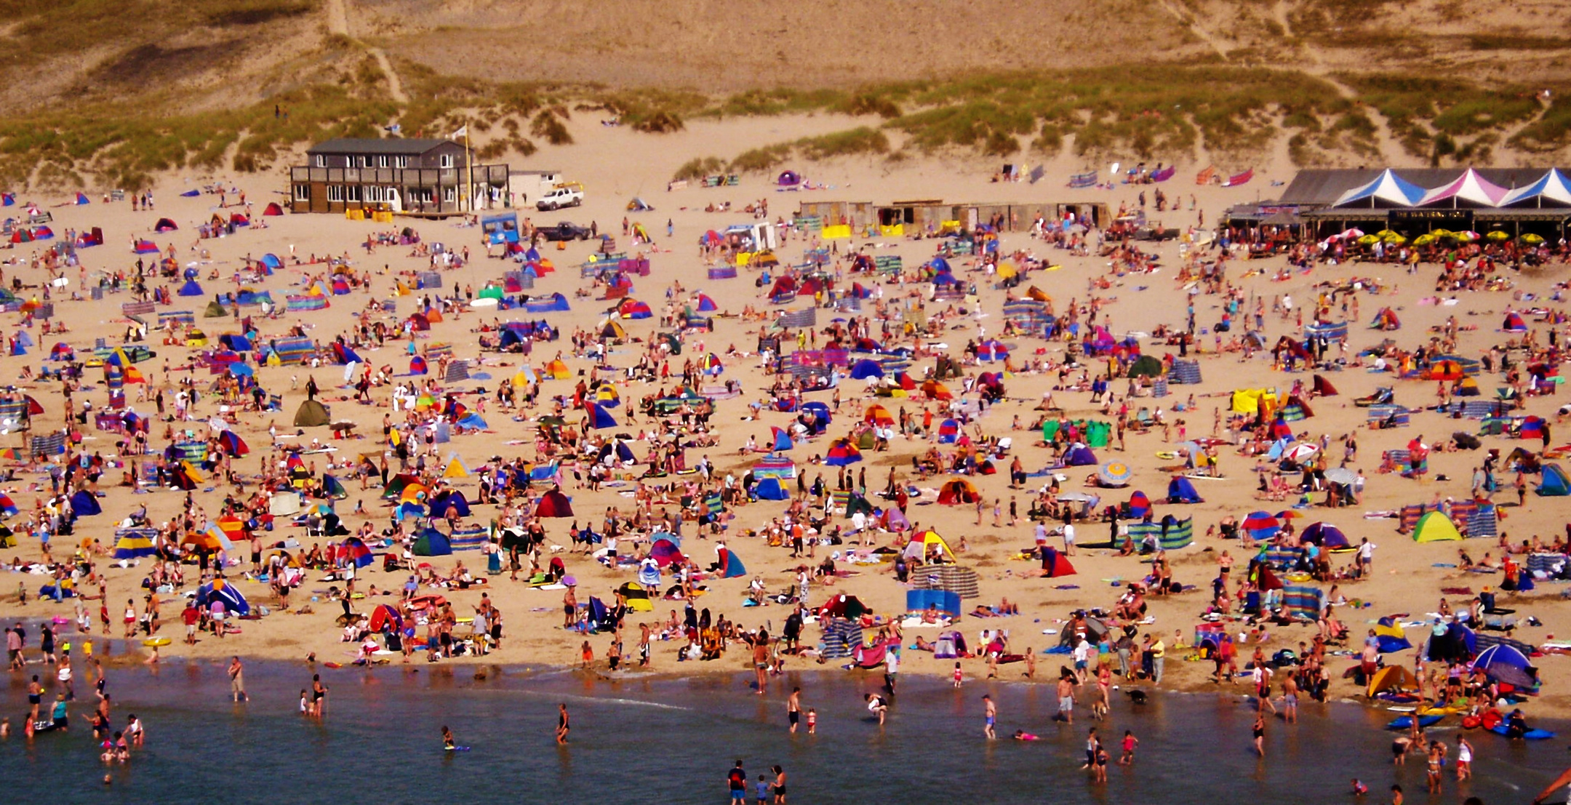
Entrance task
Can you spot the following in the picture?
A truck?
Someone swimming?
A yellow windbreaker?
© We Teach
Notes:
Aim: For pupils to consider how they process information to collect specific items. Links to lesson aim of skinning and scanning.

Slide 2
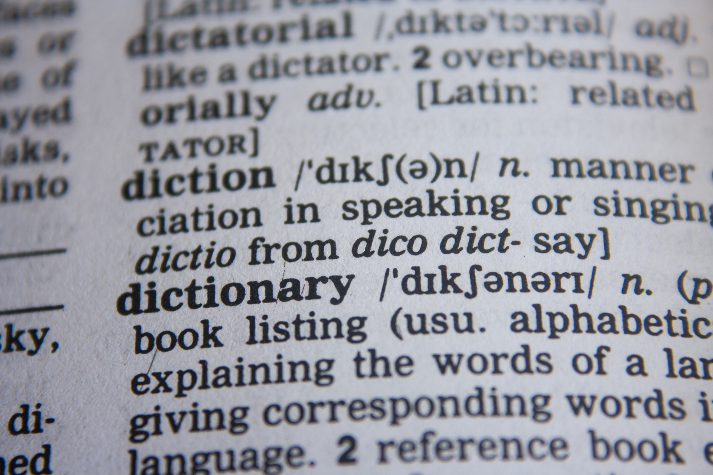
Entrance task
Can you find the following words in the picture?
Dictionary?
Diction?
Corresponding?
© We Teach
Notes:
Aim: For pupils to consider how they process information to collect specific items. Links to lesson aim of skinning and scanning.

Slide 3
Lesson aims
How can I read at speed and locate the correct information?
Tier 2 vocabulary
Scan (v): Read quickly to find a specific thing.
Skim (v): Read quickly to understand the overall idea of a piece.
© We Teach
Notes:
Depending on the ability of the group, the tier 2 words can be amended.

Slide 4
How did you do in the entrance task?
How did you approach this task?
What did you notice your eyes doing?
How did you know what to look for and what to ignore?
© We Teach

Slide 5

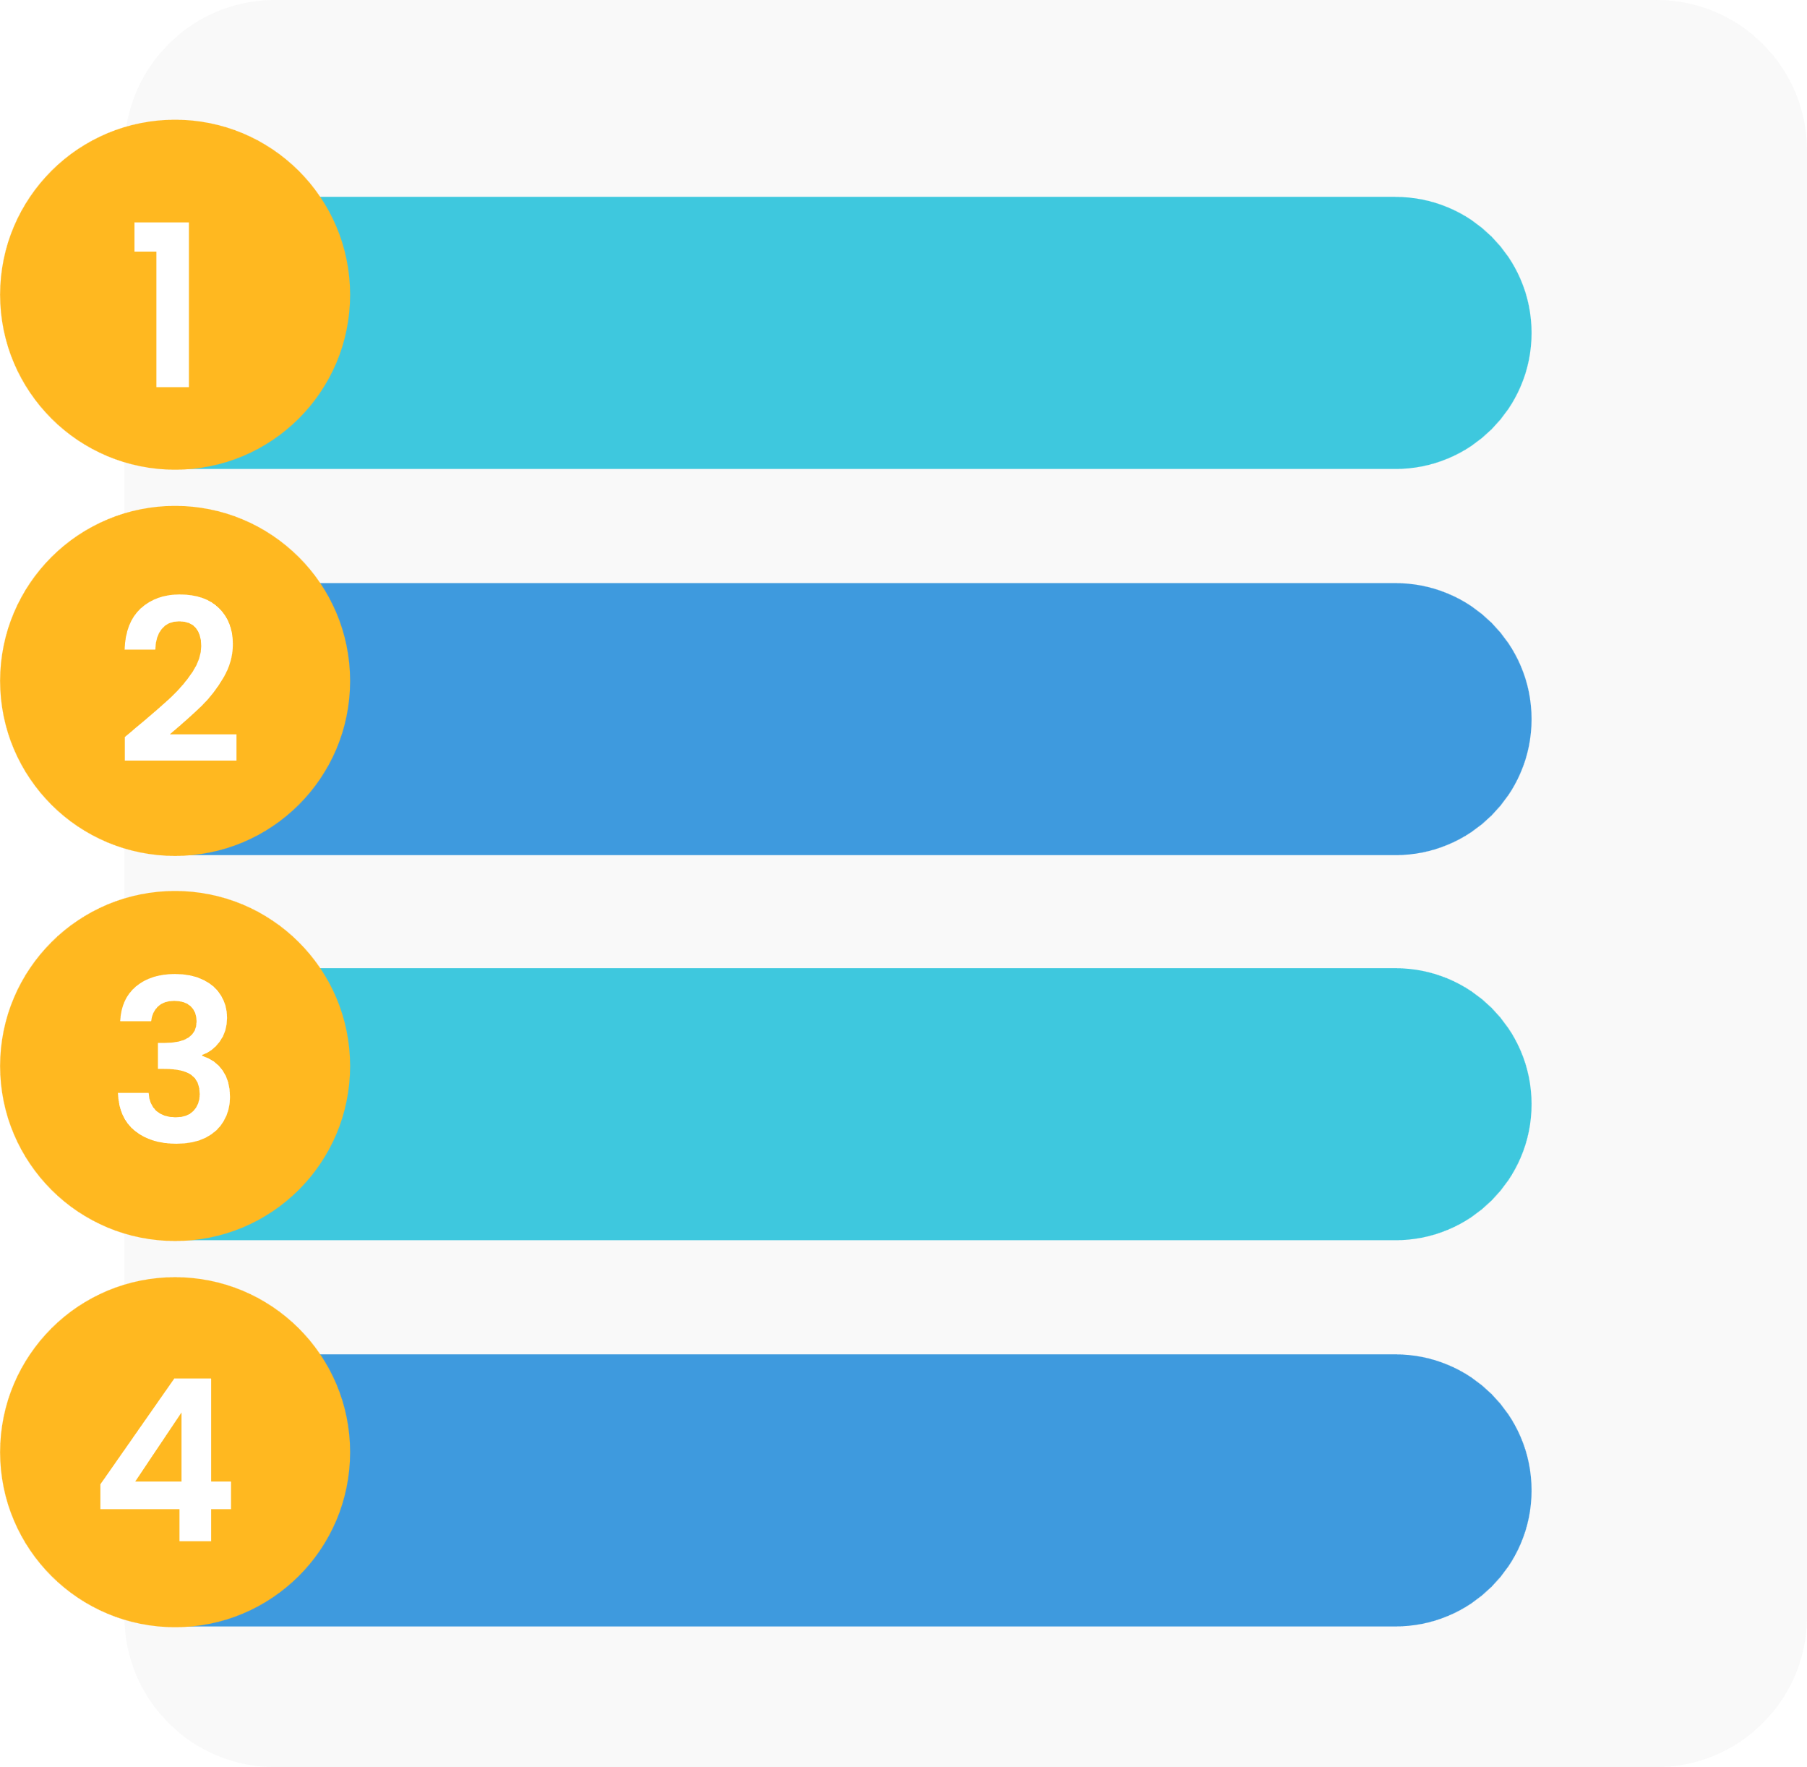
Paper 1, question 1
List question
For this question, you are asked to list 4 things from a specific part of the source material.
This requires you to read and locate the correct information, just like you did in the entrance task.
© We Teach

Slide 6

When do we skim read?
When skim reading, you aren't reading every word. Instead, you might focus on:
  The opening and closing sentences or paragraphs
  Headings and subheadings
  Key words that are highlighted or in bold
© We Teach

Slide 7
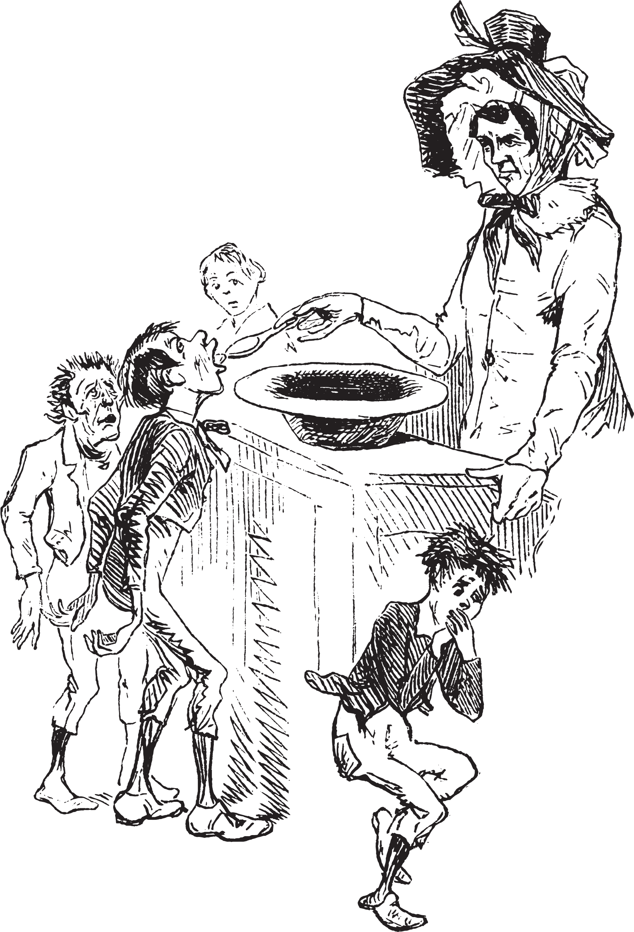
Skim reading task
Skim read the blurb from Oliver Twist to find out what it is about.
The story of Oliver Twist - orphaned, and set upon by evil and adversity from his first breath - shocked readers when it was published. After running away from the workhouse and pompous beadle Mr Bumble, Oliver finds himself lured into a den of thieves peopled by vivid and memorable characters - the Artful Dodger, vicious burglar Bill Sikes, his dog Bull's Eye, and prostitute Nancy, all watched over by cunning master-thief Fagin. Combining elements of Gothic Romance, the Newgate Novel and popular melodrama, Dickens created an entirely new kind of fiction, scathing in its indictment of a cruel society, and pervaded by an unforgettable sense of threat and mystery.
© We Teach
Notes:
Taken from Oliver Twist Penguin Classics, revised ed. edition (27 Mar. 2003) Philip Horne introduction

Slide 8
When do we scan a text?
When you scan a text, you aren't reading every word. Instead, you are looking to locate specific information. You might look for:
  Key words from the question
  Highlighted words in bold or headings and subheadings.
© We Teach

Slide 9
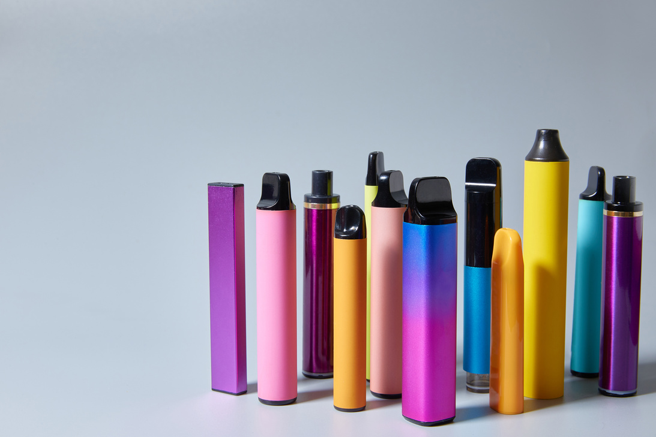
Scanning task
Scan the text to find:
  the age limit to buy an e-cigarette?
  What the Prime Minister said?
  How could they damage young people?
Lots of people are concerned about the number of children in the UK using vapes.
They're also known as e-cigarettes and should only be sold and used by people who are aged 18 or older.
Prime Minister Rishi Sunak said he was "deeply concerned" about the increase of children vaping and that the government are taking steps to tackle the issue.
Children's doctors are also calling for a complete ban on disposable vapes because they say they could damage young people's lungs.
© We Teach
Notes:
Taken from Newsround: https://www.bbc.co.uk/newsround/65276782

Slide 10
Scanning task
Scan the text to find:
  the age limit to buy an e-cigarette?
  What the Prime Minister said?
  How could they damage young people?
Lots of people are concerned about the number of children in the UK using vapes.
They're also known as e-cigarettes and should only be sold and used by people who are aged 18 or older.
Prime Minister Rishi Sunak said he was "deeply concerned" about the increase of children vaping and that the government are taking steps to tackle the issue.
Children's doctors are also calling for a complete ban on disposable vapes because they say they could damage young people's lungs.
© We Teach
Notes:
Taken from Newsround: https://www.bbc.co.uk/newsround/65276782

Slide 11




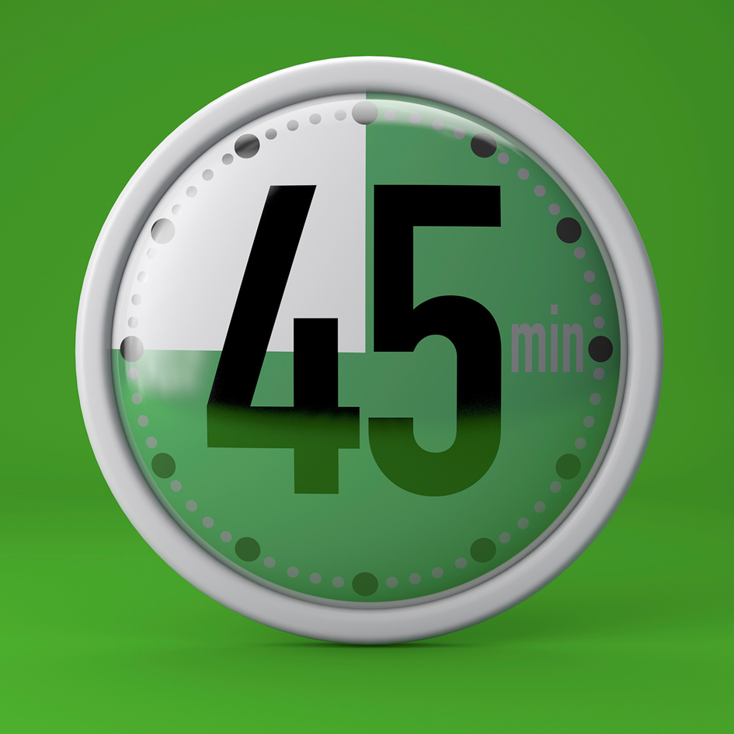
Exam focus
Paper 1 exam: Creating reading and writing
You have 1 hour 45 minutes for this exam.
It is suggested that you spend 15 minutes reading the text.
For each question, use the following timings to help:
Q1:
List
Q2: Language
Q3:
Structure
Q4:
Statement
Q5: Describe or narrative
© We Teach

Slide 12
How to approach P1, Q1
1. Read the question and identify the key words.
2. Locate the lines you need to take the information from.
3. Use skimming and scanning to find 4 responses and list.
4. Write your answers
Q1:
List
© We Teach

Slide 13
Exam focus
Let's take an exam text to develop this skill.
  Read the question and identify the key words.
Read again the first part of the source, from lines 1 to 9.
List four things about this jungle from this part of the source
Q1:
List
© We Teach
Notes:
Take from AQA November 2018 examination paper.
Extract: A Sound of Thunder by Ray Bradbury

Slide 14
Exam focus
Let's take an exam text to develop this skill.
  Read the question and identify the key words.
Read again the first part of the source, from lines 1 to 9.
List four things about this jungle from this part of the source
Q1:
List
© We Teach
Notes:
Take from AQA November 2018 examination paper.
Extract: A Sound of Thunder by Ray Bradbury

Slide 15

Exam focus
Now, skim and scan the extract below to find anything about the jungle.
The jungle was high and the jungle was broad. Sounds like music and flying tents filled the sky, and those were pterodactyls soaring with huge grey wings.
‘I’ve hunted tiger, wild boar, buffalo, elephant, but now, this is it,’ said Eckels.
‘I’m shaking like a kid.’ ‘Ah,’ said Travis.
Everyone stopped.
Travis raised his hand. ‘Ahead,’ he whispered, ‘in the mist. There he is. There’s his Royal Majesty now.’
The jungle was wide and full of twitterings, rustlings, murmurs, and sighs
© We Teach
Notes:
Teachers might set this as an individual task or model it.

Slide 16
Exam focus - possible answers
Now, skim and scan the extract below to find anything about the jungle.
The jungle was high and the jungle was broad. Sounds like music and flying tents filled the sky, and those were pterodactyls soaring with huge grey wings.
‘I’ve hunted tiger, wild boar, buffalo, elephant, but now, this is it,’ said Eckels.
‘I’m shaking like a kid.’ ‘Ah,’ said Travis.
Everyone stopped.
Travis raised his hand. ‘Ahead,’ he whispered, ‘in the mist. There he is. There’s his Royal Majesty now.’
The jungle was wide and full of twitterings, rustlings, murmurs, and sighs
© We Teach
Notes:
Possible responses:
The jungle was high
There were tall trees
The jungle was broad
The jungle was wide
The jungle was big
Musical sounds filled the sky
The sound of flying tents/ pterodactyls filled the sky
It was noisy/ loud Pterodactyls soared in the air
There were pterodactyls
It was misty in the jungle
The jungle was full of twitterings
The jungle was full of (peaceful/ natural) noises/ The jungle was peaceful
The jungle was full of rustling
The jungle was full of murmurs
The jungle was full of sighs
There is a dinosaur/ Tyrannosaurus Rex There are dinosaurs
The jungle was prehistoric

Slide 17
Exam focus
When writing your response:
  You don't need to use quotations
  Try to write using the key information from the text
  Don't add lots of detail - you only have 5 minutes.
Q1:
List
© We Teach

Slide 18
Exam focus - possible answers
The jungle was high | The sound of flying tents/ pterodactyls filled the sky | The jungle was full of rustling
There were tall trees | It was noisy/ loud Pterodactyls soared in the air | The jungle was full of murmurs
The jungle was broad | There were pterodactyls | The jungle was full of sighs
The jungle was wide | It was misty in the jungle | The jungle was peaceful
The jungle was big | The jungle was full of twitterings | The jungle was prehistoric
Musical sounds filled the sky | The jungle was full of (peaceful/ natural) noises | There is a dinosaur/ Tyrannosaurus Rex There are dinosaurs
© We Teach

Slide 19
Consolidate your learning
Using your skills so far, complete the next task in timed conditions.
Read the question and identify the key words.
Q:Read again the first part of the source, from lines 1 to 5. List four things about Zoe’s surroundings from this part of the source.
Q1:
List
© We Teach
Notes:
Take from AQA November 2019 examination paper.
Extract: The Silent Land by Graham Joyce

Slide 20

Consolidate your learning
Now, skim and scan the extract below.
It was snowing again. Gentle six-pointed flakes from a picture book were settling on her jacket sleeve. The mountain air prickled with ice and the smell of pine resin.
Several hundred metres below lay the dark outline of Saint-Bernard-en-Haut, their Pyrenean resort village; across to the west, the irregular peaks of the mountain range.
© We Teach
Notes:
Teachers might set this as an individual task or model it.

Slide 21
Consolidate your learning
Now, skim and scan the extract below.
It was snowing again. Gentle six-pointed flakes from a picture book were settling on her jacket sleeve. The mountain air prickled with ice and the smell of pine resin.
Several hundred metres below lay the dark outline of Saint-Bernard-en-Haut, their Pyrenean resort village; across to the west, the irregular peaks of the mountain range.
© We Teach
Notes:
Teachers might set this as an individual task or model it.

Slide 22
Consolidate your learning - possible answers
It is snowing | The snow is gentle | The snow has six-pointed flakes
The snow looks like it was from a picture book | The snow is settling | She is on a mountain
The air is icy | The air smells of pine resin | Below her is Saint-Bernard-en-Haut
To the west she can see the Pyranees | The mountain range has irregular peaks | The village is several hundred metres below her
© We Teach

Slide 23
Lesson aims
How can I read at speed and locate the correct information?
Tier 2 vocabulary
Scan (v): Read quickly to find a specific thing.
Skim (v): Read quickly to understand the overall idea of a piece.
© We Teach
Notes:
Depending on the ability of the group, the tier 2 words can be amended.

