Slide 1
Learning objective
Practise using a range of punctuation for accuracy.
Revise/learn how and why writers use the dash punctuation mark.
© We Teach

Slide 2
‘Frankenstein’ story (Usborne texts) The lack of punctuation in the text below is monstrous! Can you add in the capital letters and punctuation and make it less of a hideous sight? You need to add: 5 capital letters 4 full stops 5 commas 1 dash
completely obsessed victor allowed nothing to stand in his way not even his respect for the dead for his experiment he needed to build a body at nightfall he secretly visited dark dissecting rooms and damp graveyards stealing bones and fragments of flesh out of these horrors he meant to create a completely new creature
© We Teach

Slide 3
‘Frankenstein’ story (adapted from Usborne texts) The lack of punctuation in the text below is monstrous! Can you add in the capital letters and punctuation and make it less of a hideous sight?
Completely obsessed, Victor allowed nothing to stand in his way - not even his respect for the dead. For his experiment, he needed to build a body. At nightfall, he secretly visited dark dissecting rooms and damp graveyards, stealing bones and fragments of flesh. Out of these horrors, he meant to create a completely new creature.
© We Teach

Slide 4
A writer’s use of punctuation
Why has the writer used a comma after the following sections of text? Completely obsessed, For his experiment, At nightfall, Out of these horrors,
2. Why has the writer uses a dash: what does it reveal about the character Doctor Frankenstein? Completely obsessed, Victor allowed nothing to stand in his way - not even his respect for the dead.
© We Teach

Slide 5
A writer’s use of punctuation
Why has the writer used a comma after the following sections of text? Completely obsessed, For his experiment, At nightfall, Out of these horrors,
2. Why has the writer uses a dash: what does it reveal about the character Doctor Frankenstein? Completely obsessed, Victor allowed nothing to stand in his way - not even his respect for the dead.
These are all examples of phrases and therefore require a comma.
The dash has been used to add an interruption to the sentence. It makes the reader focus on how low Doctor Frankenstein is willing to stoop to achieve his goals.
© We Teach

Slide 6
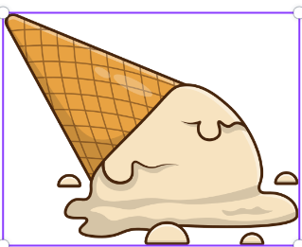
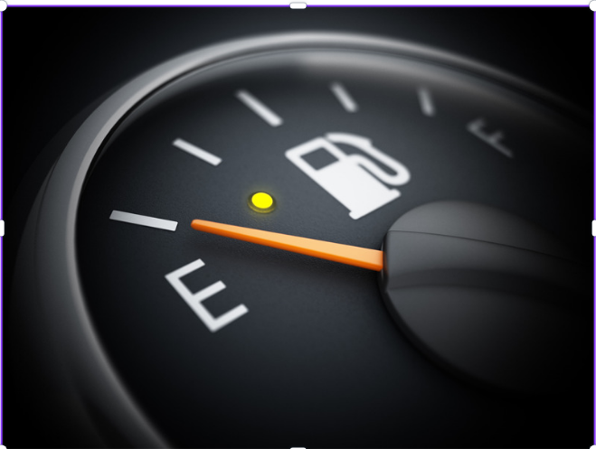
Using punctuation Can you write a sentence using a dash to describe each of the pictures below?
© We Teach

