Slide 1
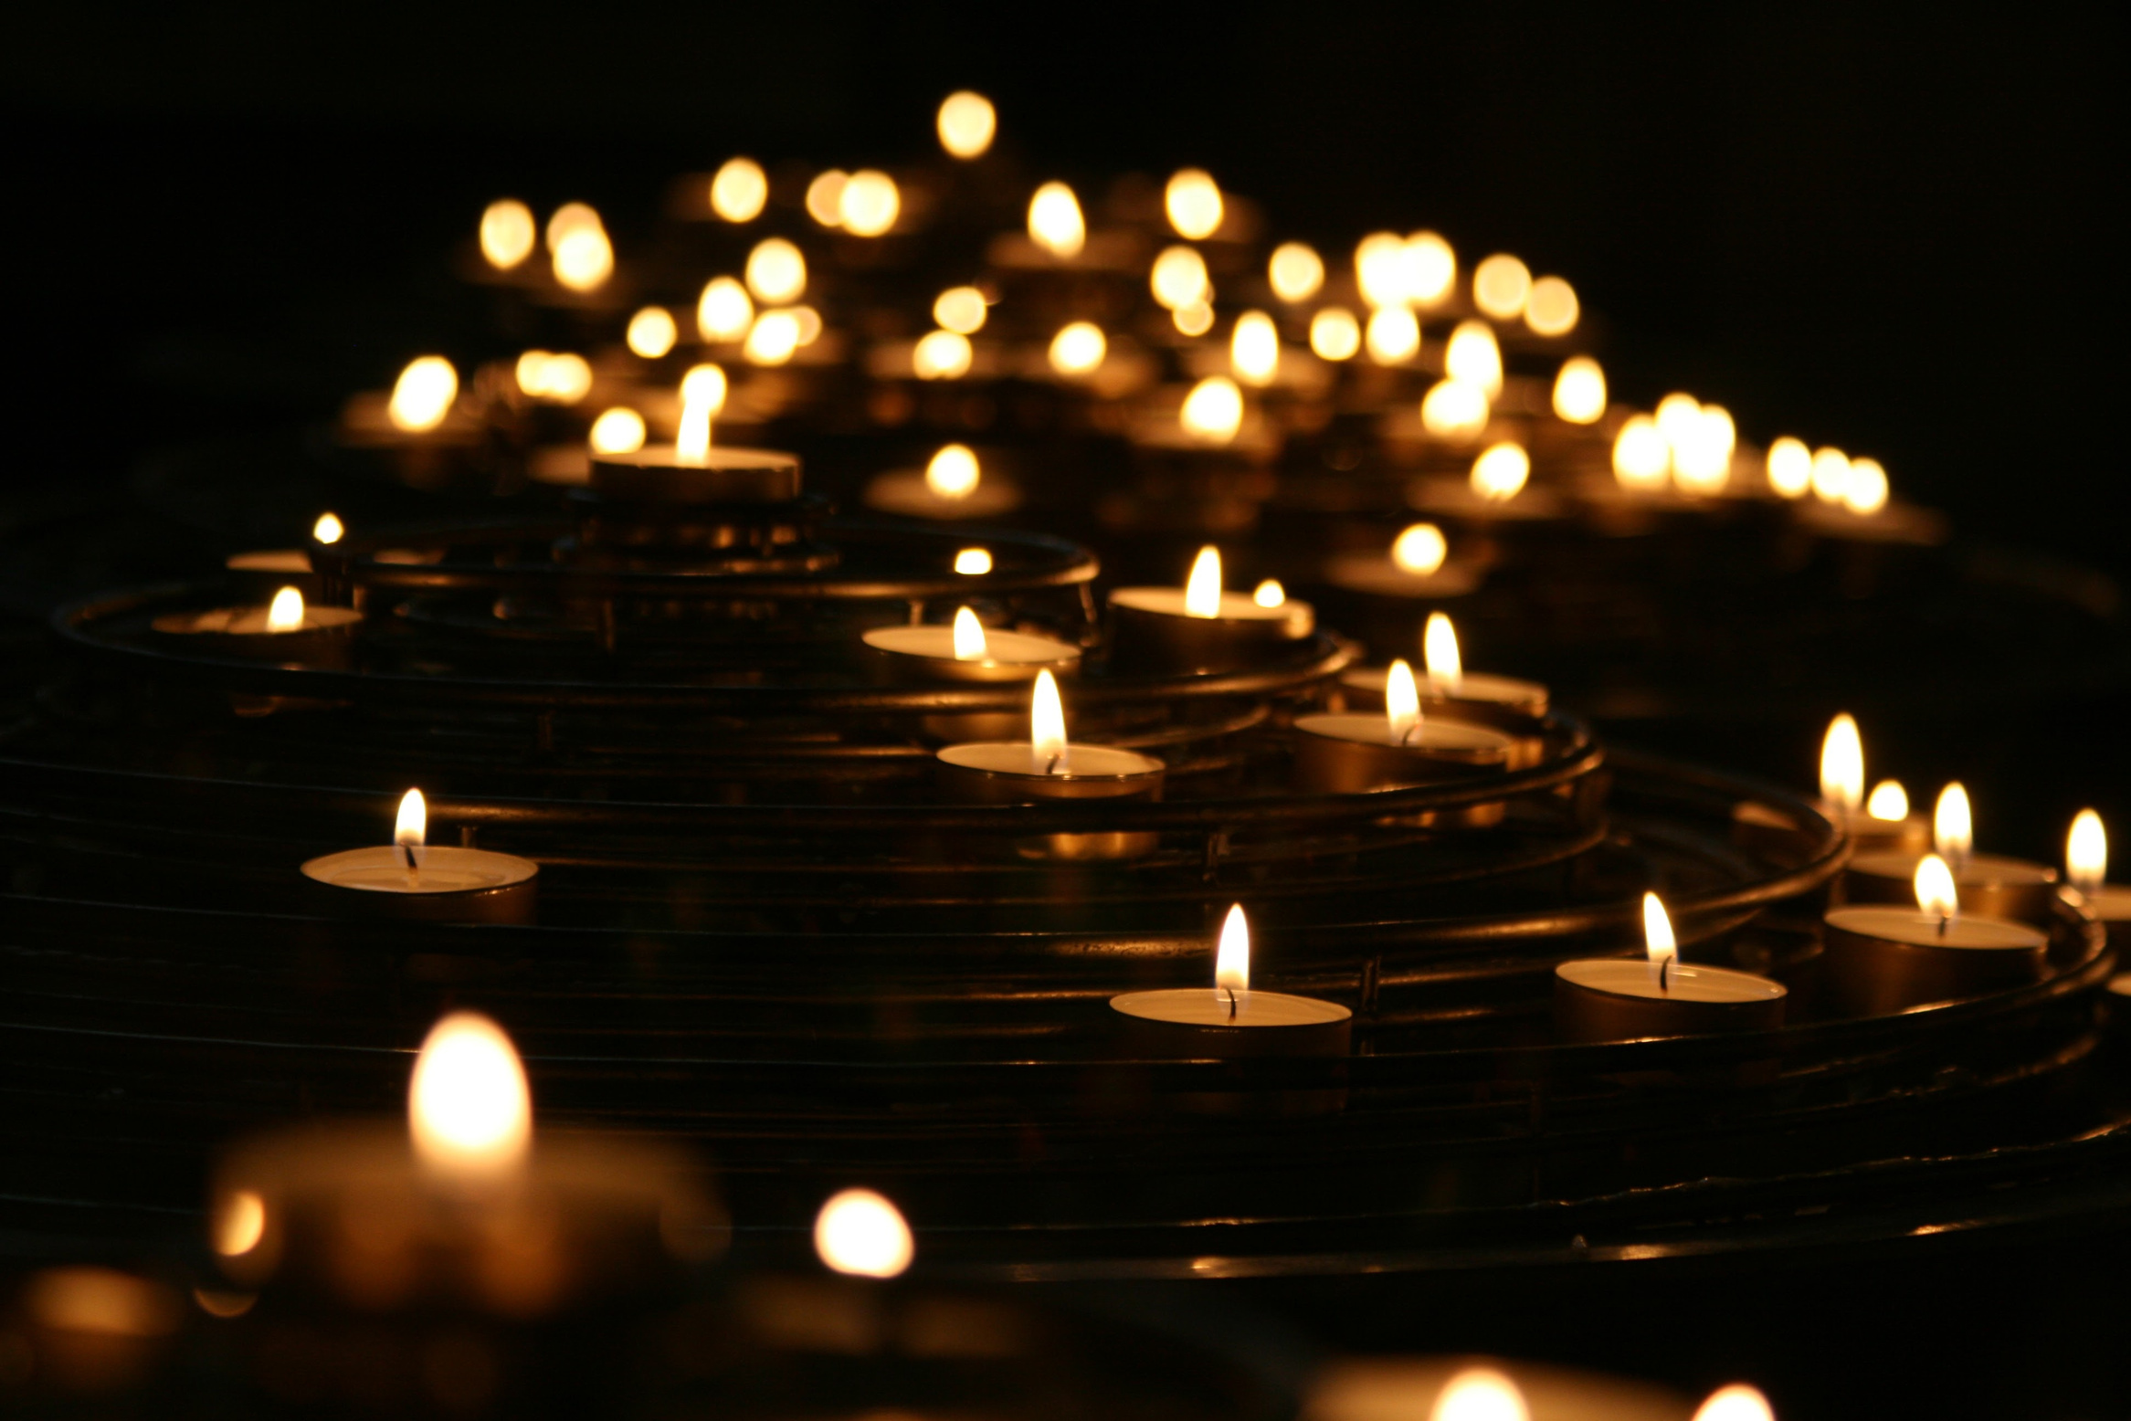
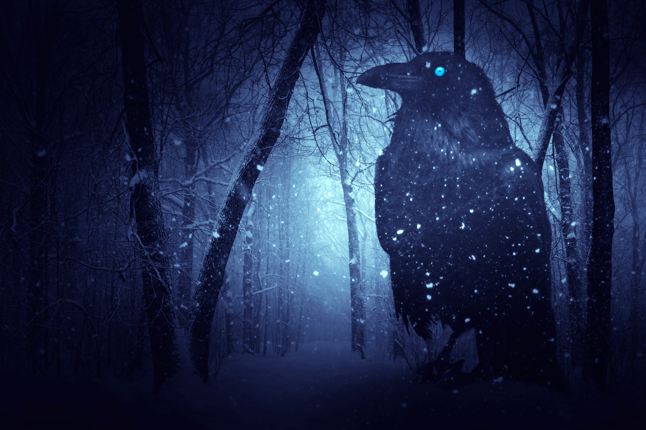
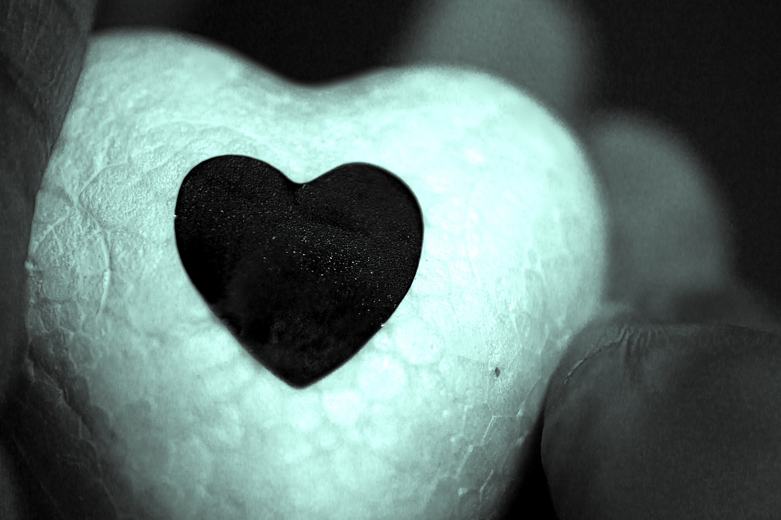
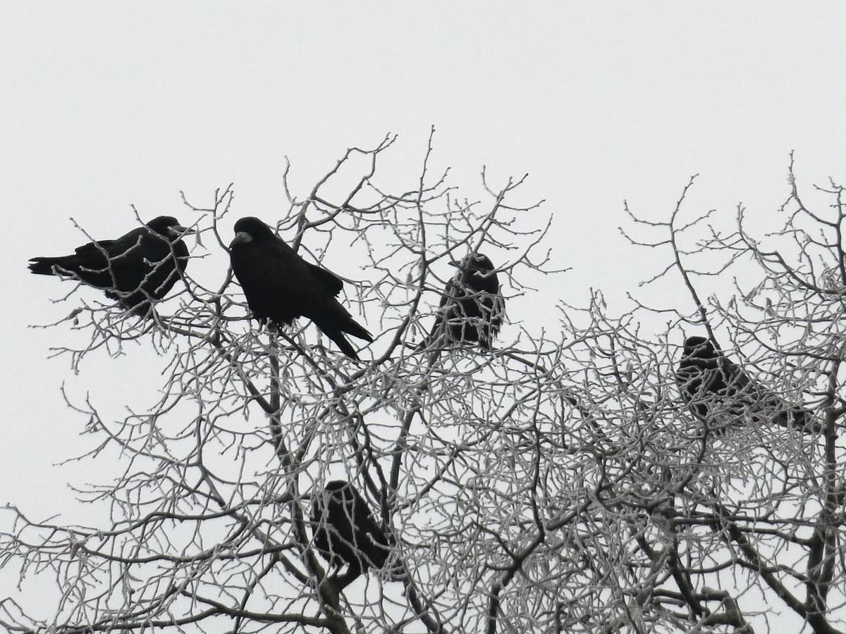
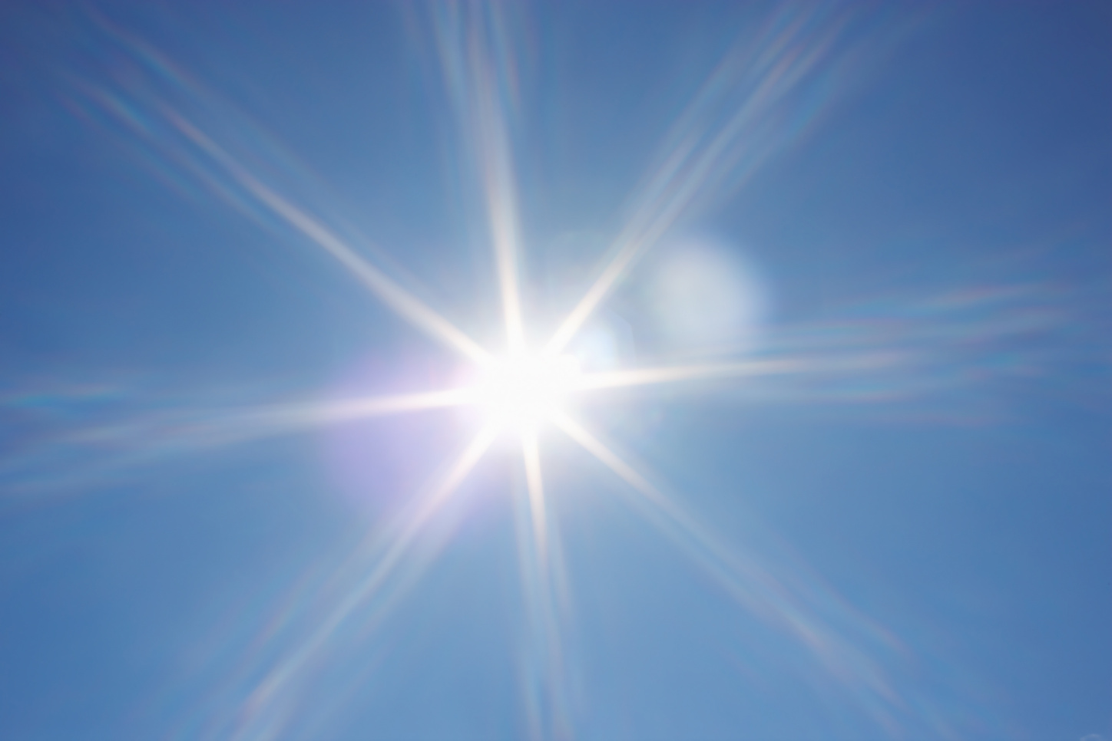
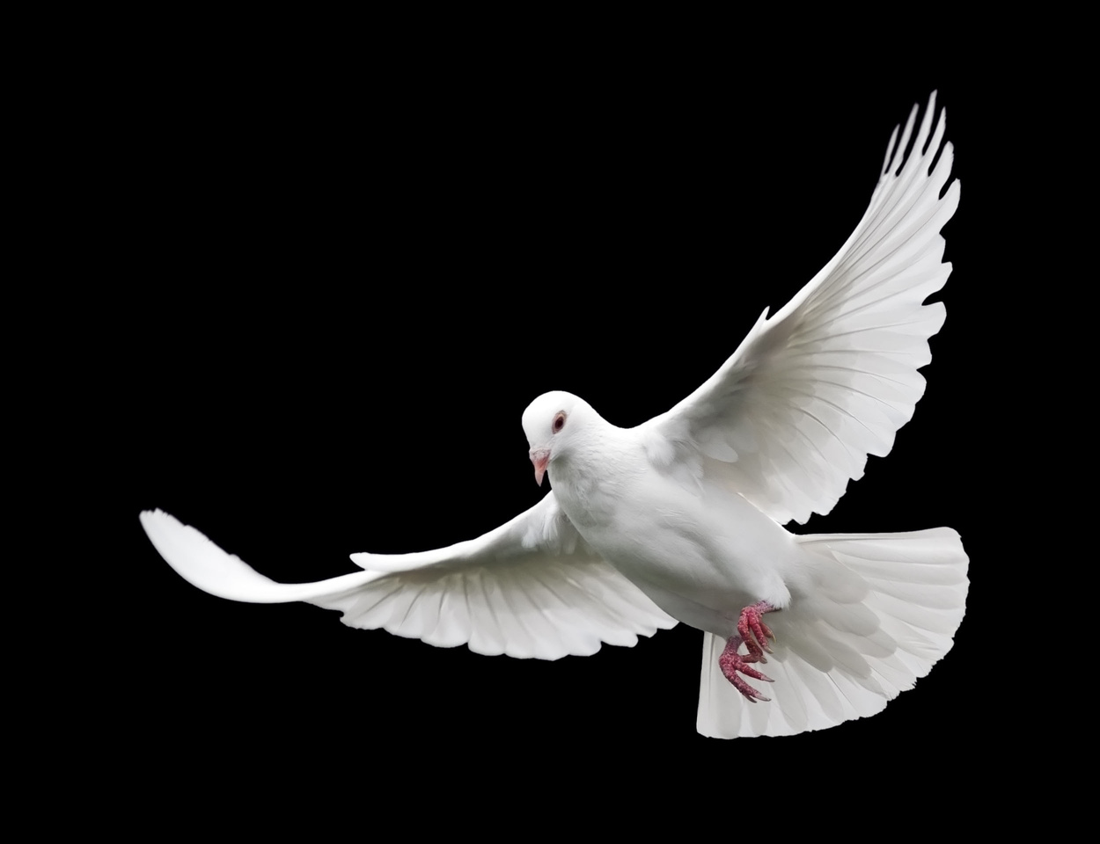
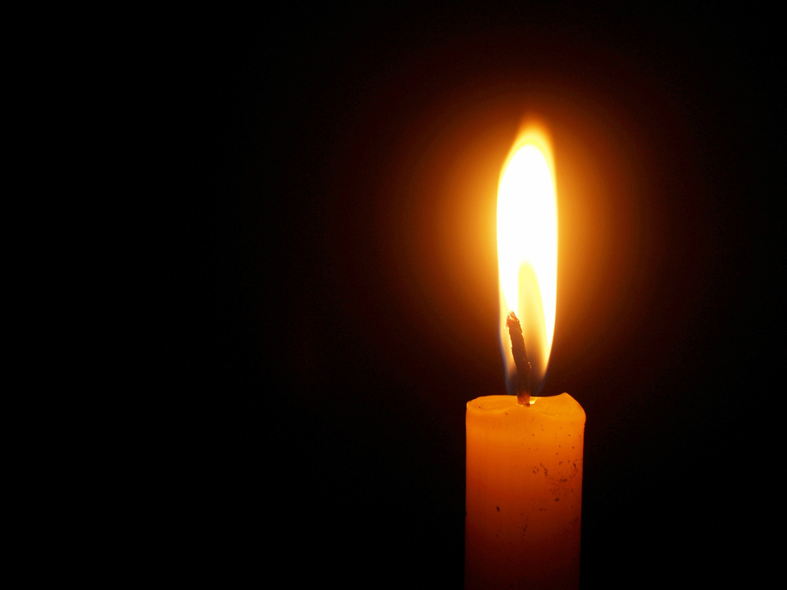


Entrance task
Look at the images.
What can you see?
What do the images make you think of?
© We Teach
Notes:
Try to draw out connotations related to symbols dark, light, fire.

Slide 2
Entrance task
Now, watch and listen to the clips.
Do you notice a common theme in the songs?
Do the songs and images link?
© We Teach
Notes:
YouTube song links
Trigger warning: Please be aware of the needs of your group as some lyrics contain sensitive lyrics. You may wish to be selective in what you choose to share with your pupils.
• Ring of Fire – Johnny Cash https://www.youtube.com/watch?v=QfCOJLRk2D4
• Cover of Light My Fire – Will Young https://www.youtube.com/watch?v=BNwIqFGna2E
• There is a Light That Never Goes Out – The Smiths https://www.youtube.com/watch?v=RFTbeQ_O8U0
• Life Support – Sam Smith https://www.youtube.com/watch?v=7DqjJxnWxAQ
• Shining Light – Ash https://www.youtube.com/watch?v=0pYkHZUv1uk
• XO - Beyonce https://www.youtube.com/watch?v=3xUfCUFPL-8
• Let Her Go – Passenger https://www.youtube.com/watch?v=UqaApGePWVE

Slide 3
Lesson aims
How does Shakespeare use symbolism in Romeo and Juliet?
Tier 2 vocabulary
Captivated (v): Hold the interest and attention of.
Impulsive (adj): Acting without thinking first.
Infatuation (n): An intense, but short-lived passion for someone.
© We Teach

Slide 4
Symbolism
From the entrance track, what key symbols did you spot?
© We Teach
Notes:
Try to draw out connotations related to symbols dark, light, fire.

Slide 5

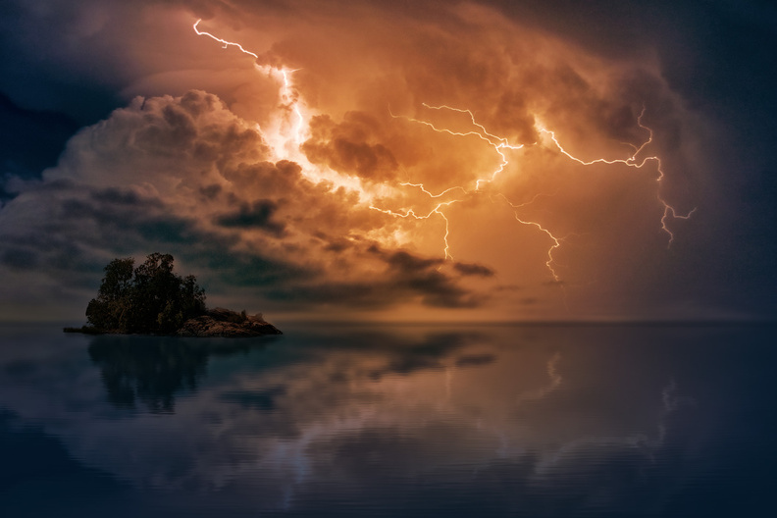

Connotations
One way to develop our analysis, is to consider the connotations of words or images used by writers.
A connotation is an idea or feeling we get some a word. This can be implied. Connotations can also be positive or negative.
© We Teach

Slide 6
Connotations
For example, the weather can be useful when thinking about connotations.
What do you feel or what are connotations of the different images of weather?
© We Teach

Slide 7
Connotations
From the entrance track, what are the connotations of the images?
© We Teach

Slide 8
Connotations
From the entrance track, what are the connotations of the images?
© We Teach

Slide 9
Connotations
From the entrance track, what are the connotations of the images?
© We Teach

Slide 10
Connotations
From the entrance track, what are the connotations of the images?
© We Teach

Slide 11
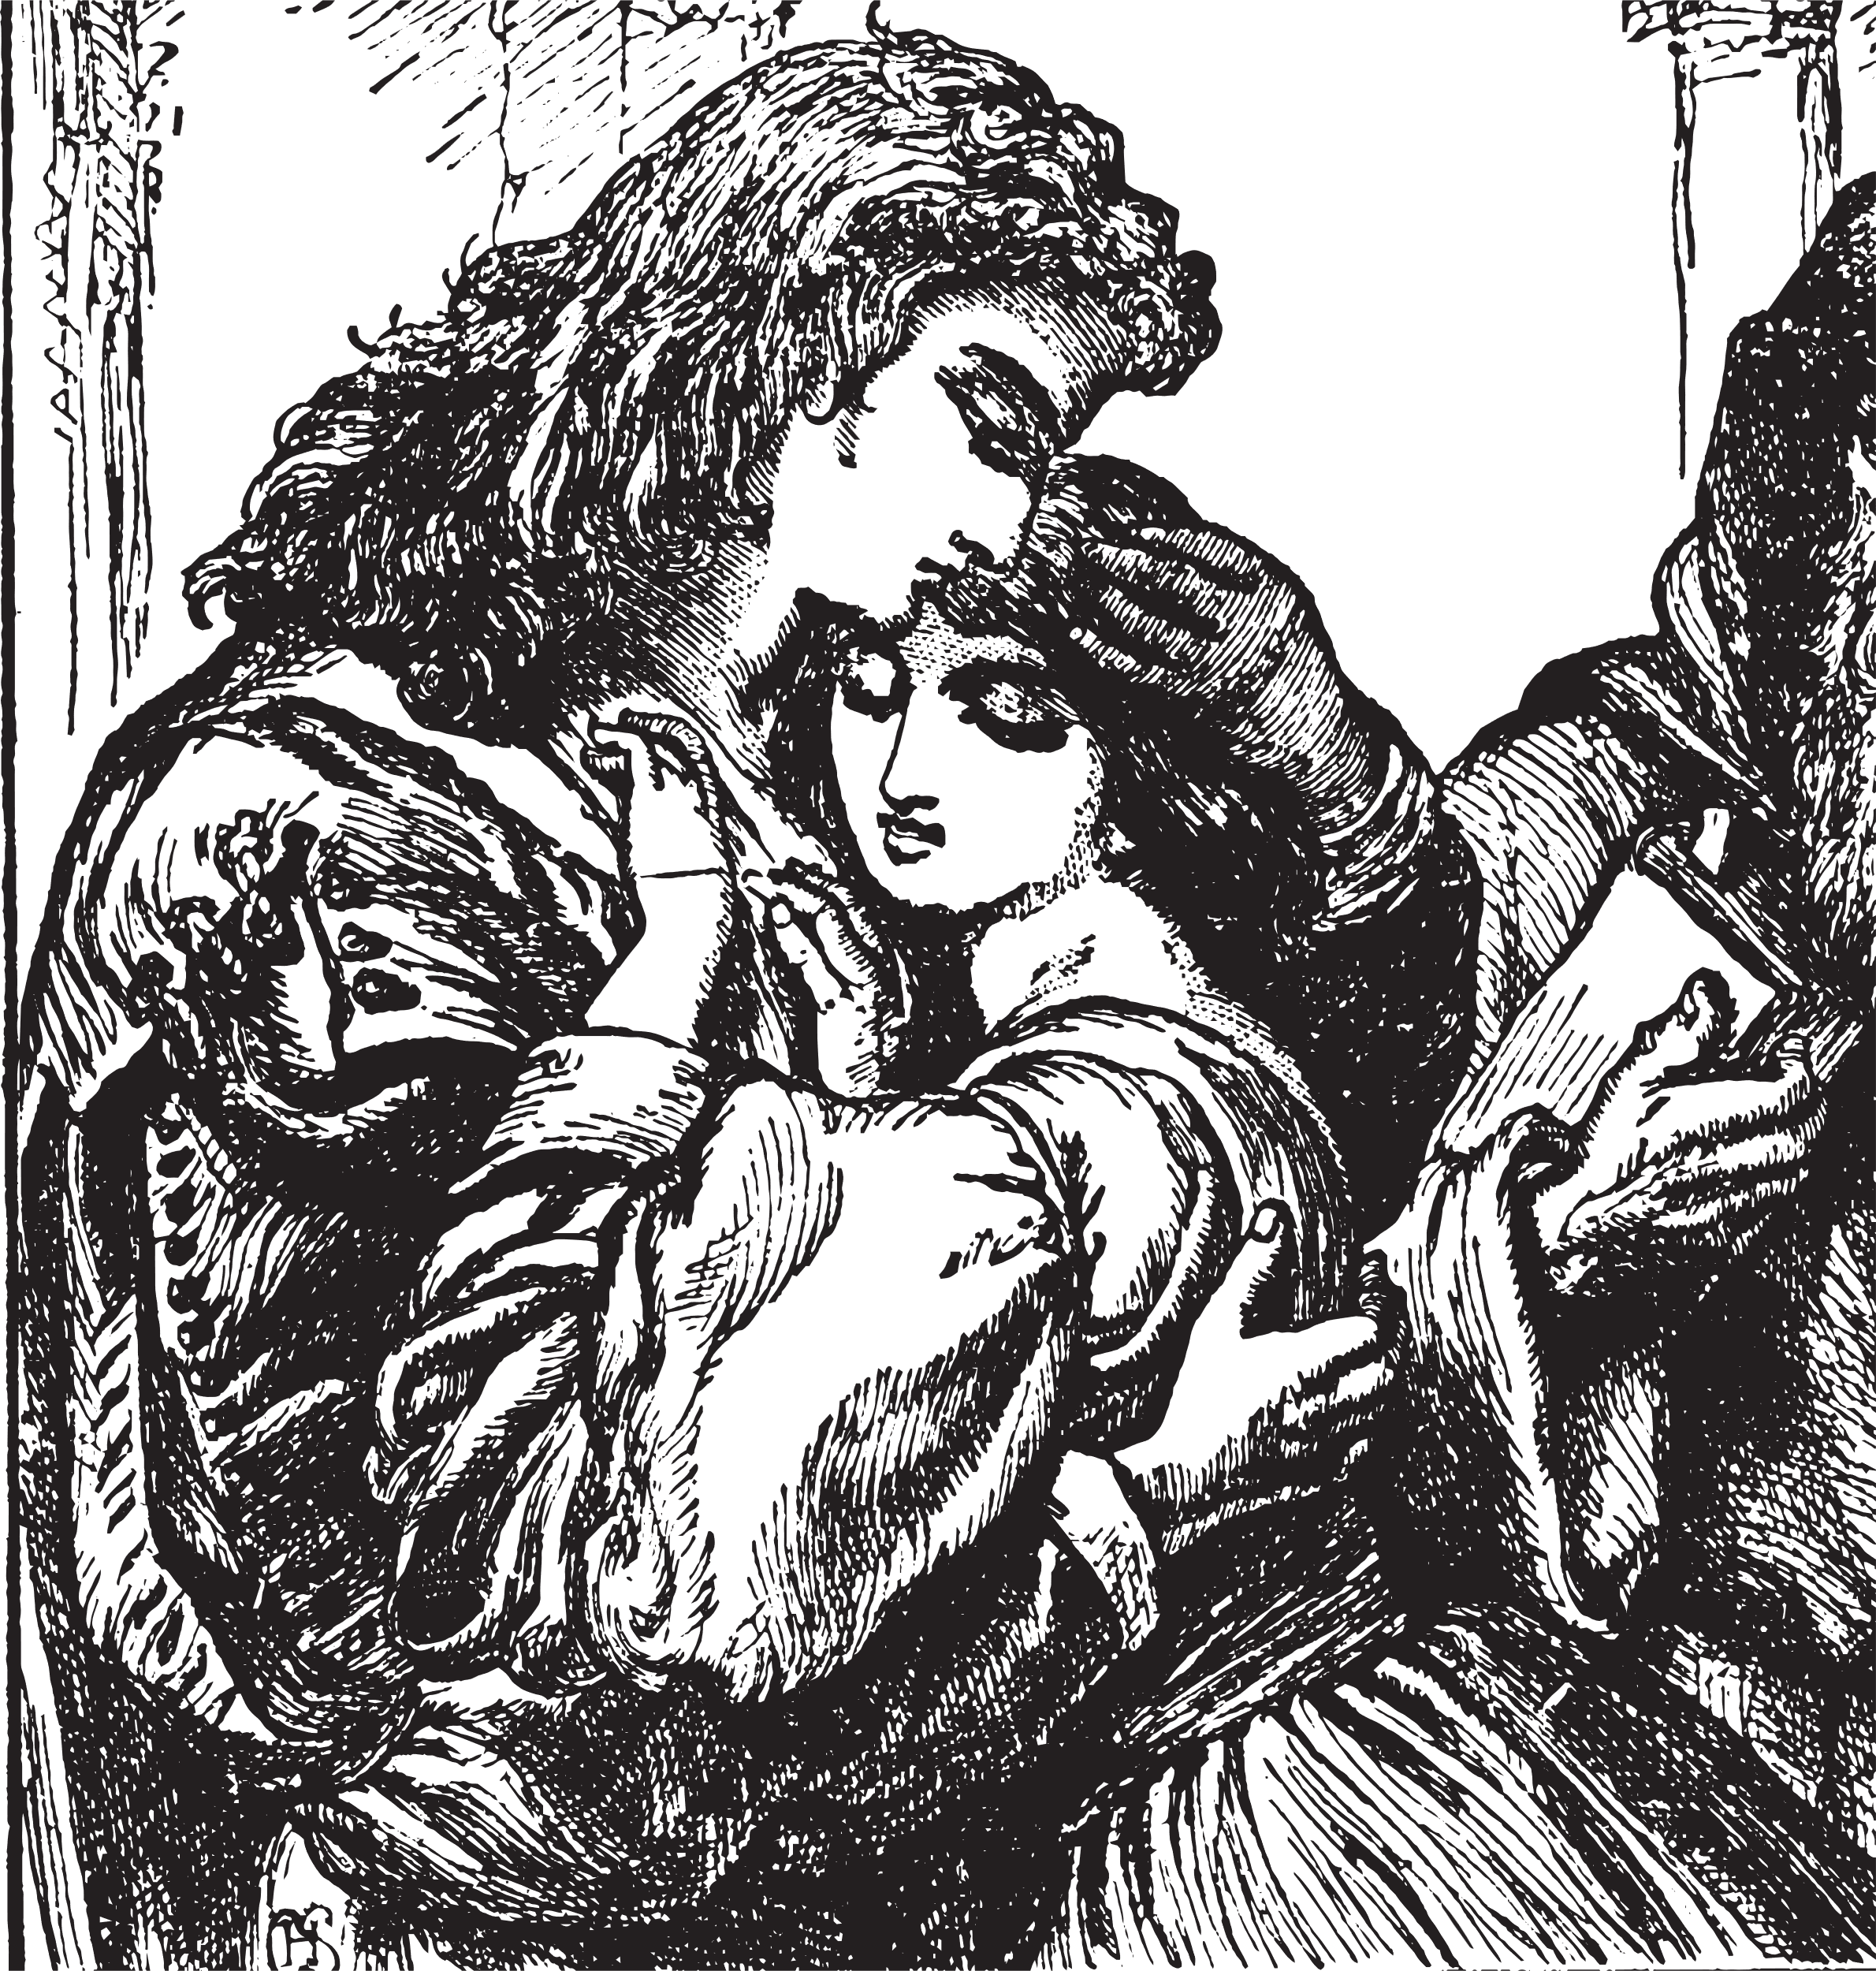
Act 1, scene 5: The Capulet ball
In today's extract, we are going to examine the language Shakespeare uses to show Romeo's feelings towards Juliet when he first sees her.
Watch the following clip and consider the following questions:
  What are Romeo's feelings towards Rosaline in this scene?
  What are Romeo's feelings towards Juliet in this scene?
  How does Shakespeare present Romeo's attitude to love?
© We Teach
Notes:
Any performance of the text can be used.
The following clip is from Franco Zeffirell 1968 version:
https://www.youtube.com/watch?v=IrpOxPctRyU

Slide 12
Act 1, scene 5: The Capulet ball
Task: Can you spot any of the images from the entrance task?
O, she doth teach the torches to burn bright!
It seems she hangs upon the cheek of night
As a rich jewel in an Ethiop’s ear—
Beauty too rich for use, for Earth too dear.
So shows a snowy dove trooping with crows
As yonder lady o’er her fellows shows.
The measure done, I’ll watch her place of stand
And, touching hers, make blessèd my rude hand.
Did my heart love till now? Forswear it, sight,
For I ne’er saw true beauty till this night.
© We Teach

Slide 13
Annotation: Act 1, scene 5
What do you notice about the structure of Romeo's speech?
Consider the use of rhyme and syllables.
O, she doth teach the torches to burn bright!
It seems she hangs upon the cheek of night
As a rich jewel in an Ethiop’s ear—
Beauty too rich for use, for Earth too dear.
So shows a snowy dove trooping with crows
As yonder lady o’er her fellows shows.
The measure done, I’ll watch her place of stand
And, touching hers, make blessèd my rude hand.
Did my heart love till now? Forswear it, sight,
For I ne’er saw true beauty till this night.
© We Teach
Notes:
Link to RSC about the use of rhyming couplets:
https://www.rsc.org.uk/shakespeare-learning-zone/romeo-and-juliet/language/key-terms#

Slide 14
Annotation: Act 1, scene 5
Romeo uses rhyming couplets of iambic pentameter. This was he typical style for sonnets at the time.
Watch the actors from RSC examine the effect of rhyming couplets and consider why Shakespeare has included them.
O, she doth teach the torches to burn bright!
It seems she hangs upon the cheek of night
As a rich jewel in an Ethiop’s ear—
Beauty too rich for use, for Earth too dear.
So shows a snowy dove trooping with crows
As yonder lady o’er her fellows shows.
The measure done, I’ll watch her place of stand
And, touching hers, make blessèd my rude hand.
Did my heart love till now? Forswear it, sight,
For I ne’er saw true beauty till this night.
© We Teach
Notes:
Link to RSC about the use of rhyming couplets:
https://www.rsc.org.uk/shakespeare-learning-zone/romeo-and-juliet/language/key-terms#

Slide 15
Annotation: Act 1, scene 5
O, she doth teach the torches to burn bright!
What might Romeo imply about Juliet through the verb 'teach'?
What are the connotations of the image of torches and burning bright?
How does Shakespeare present Romeo's feelings about Juliet here?
© We Teach
Notes:
Depending on your group, you may want to re-cap some of the techniques covered.

Slide 16
Annotation: Act 1, scene 5
It seems she hangs upon the cheek of night
As a rich jewel in an Ethiop’s ear
What are the connotations of the image of a rich jewel?
How does the simile describing a jewel in an Ethiop's ear link to Juliet?
How does Shakespeare use dark and light imagery in this quote?
© We Teach
Notes:
Depending on your group, you may want to re-cap some of the techniques covered.

Slide 17
Annotation: Act 1, scene 5
Beauty too rich for use, for Earth too dear.
Why might Shakespeare present Romeo as focused on Juliet's 'beauty'?
How does Shakespeare present Romeo's view of Juliet?
How does Shakespeare use hyperbole here?
© We Teach

Slide 18
Annotation: Act 1, scene 5
So shows a snowy dove trooping with crows
What are the connotations of a 'dove' and 'crows'?
Assonance and sibilance elongates words. Why might Shakespeare present Romeo's words as being long/slow here?
How does Shakespeare convey Romeo's feelings here?
© We Teach

Slide 19
Annotation: Act 1, scene 5
I’ll watch her place of stand
And, touching hers, make blessèd my rude hand.
What does Shakespeare reveal about Romeo's plan?
What are the connotations of 'blessèd'? Consider religious imagery.
Why does Shakespeare juxtapose 'blessèd' and 'rude'?
© We Teach

Slide 20
Annotation: Act 1, scene 5
Did my heart love till now? Forswear it, sight,
For I ne’er saw true beauty till this night.
What does Romeo's question suggest about his feelings?
How does Shakespeare use hyperbole in this quotation?
How does Shakespeare mirror this scene with Act 1, scene 1?
© We Teach

Slide 21

Consolidate your learning
Written task: How does Shakespeare use symbolism to present Romeo's feelings towards Juliet in this scene?
Exam focus In the exam, you will be expected to analyse the methods Shakespeare uses. Look at the following example responses to consider which candidate creates a developed response.
© We Teach

Slide 22
Consolidate your learning
Student 1: | Student 2:
When Romeo meets Juliet he says ‘she doth teach the torches to burn bright!’ This shows that she is bright and that he loves her. | When Romeo first meets Juliet he says ‘she doth teach the torches to burn bright!’ to show his feelings. Shakespeare uses imagery of a ‘torch’ and fire which imply light, energy and life. Romeo states that she is brighter than anything else showing us that Romeo is captivated by Juliet as she dominates the room.
© We Teach

Slide 23


Consolidate your learning
Student 1:
When Romeo meets Juliet he says ‘she doth teach the torches to burn bright!’ This shows that she is bright and that he loves her.
What went well?
Reference to the text.
Comment on the quotation.
To improve, the student could:
Try to explore connotations of the words in the quotation.
Avoid repeating the words in the quote as part of the explanation.
© We Teach

Slide 24
Consolidate your learning
Student 2:
When Romeo first meets Juliet he says ‘she doth teach the torches to burn bright!’ to show his feelings. Shakespeare uses imagery of a ‘torch’ and fire which imply light, energy and life. Romeo states that she is brighter than anything else showing us that Romeo is captivated by Juliet as she dominates the room.
What went well?
Reference to the text.
Explores the methods Shakespeare uses.
Zooms in on key words and examines connotations.
To improve, the student could:
Use tentative phrasing, such as could or might to explore possibilities.
Zoom in on other methods in the quotation.
© We Teach

Slide 25
Consolidate your learning
Using the quotations below, create your own response.
Task: How does Shakespeare use symbolism to present Romeo's feelings towards Juliet in this scene?
  'She hangs upon the cheek of night Like a rich jewel in an Ethiope’s ear.'
  'So shows a snowy dove trooping with crows.'
  'For I ne’er saw true beauty till this night.'
Tier 2 vocabulary
Captivated (v): Hold the interest and attention of.
Impulsive (adj): Acting without thinking first.
Infatuation (n): An intense, but short-lived passion for someone.
© We Teach

Slide 26

Consolidate your learning
Use the following sentence stems to help:
  Shakespeare presents Romeo as...
  The phrase/word/simile '.......' has connotations of...
  It might also symbolise...
  Shakespeare uses '.....' to convey...
  This evokes...
  In doing so, Shakespeare highlights...
© We Teach

Slide 27

Consolidate your learning
Using the checklist below, assess your progress. In the margin of your work, mark off where you have met each of the points:
  Focused on a method used
  Included a reference to the text
  Explained how the quote presents Romeo's feelings
  Zoom in and explore the connotations of specific words or phrases
  Used tentative phrases such as could or might
  Used tier 2 vocabulary
© We Teach
Notes:
This can be amended to be a class marked task using a visualiser. Alternatively, this could be a peer or self reflection task.

Slide 28
Lesson aims
How does Shakespeare use symbolism in Romeo and Juliet?
Tier 2 vocabulary
Captivated (v): Hold the interest and attention of.
Impulsive (adj): Acting without thinking first.
Infatuation (n): An intense, but short-lived passion for someone.
© We Teach

