Slide 1

School rules
  Students in year 7 will be expected to complete additional duties, such as litter picking.
  All year 9 students will be school prefects. You will attend all after school events to meet and greet parents.
  As part of Covid catch up, students will be expected to attend schools from 9-7 every day.
  To make up for lost learning during Covid, there is a compulsory summer school for 4 weeks.
  Students who fail in a subject, will have to re-sit the year. This means that you will be kept back a year.
  If you receive any negative behaviour points in a week, you will attend Saturday school.
  Students who have the most behaviour points in school will wear a sandwich board stating: My behaviour is unacceptable.
Entrance task
Read the new class rules.
What are your thoughts?
© We Teach
Notes:
You may wish to amend this in line with your school policies and systems.

Slide 2
Lesson aims
How do writers present political ideas?
Tier 2 vocabulary
Dystopia (n): An imagined place where everything is bad and it is filled with injustice.
Utopia (n): An imagined place where everything is good and it is considered to be perfect.
© We Teach

Slide 3

School rules
  Students in year 7 will be expected to complete additional duties, such as litter picking.
  All year 9 students will be school prefects. You will attend all after school events to meet and greet parents.
  As part of Covid catch up, students will be expected to attend schools from 9-7 every day.
  To make up for lost learning during Covid, there is a compulsory summer school for 4 weeks.
  Students who fail in a subject, will have to re-sit the year. This means that you will be kept back a year.
  If you receive any negative behaviour points in a week, you will attend Saturday school.
  Students who have the most behaviour points in school will wear a sandwich board stating: My behaviour is unacceptable.
Entrance task
How do the new rules affect you?
Are they fair?
Will they work?
Do you see them as a dystopia or utopia?
© We Teach

Slide 4
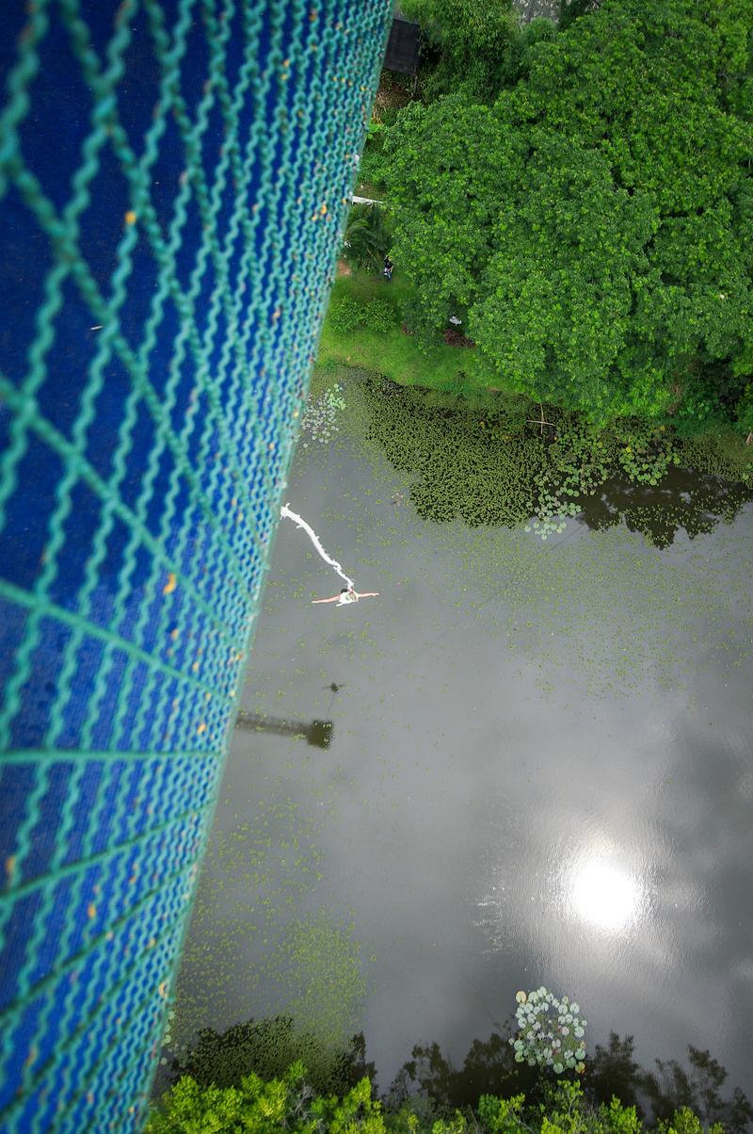

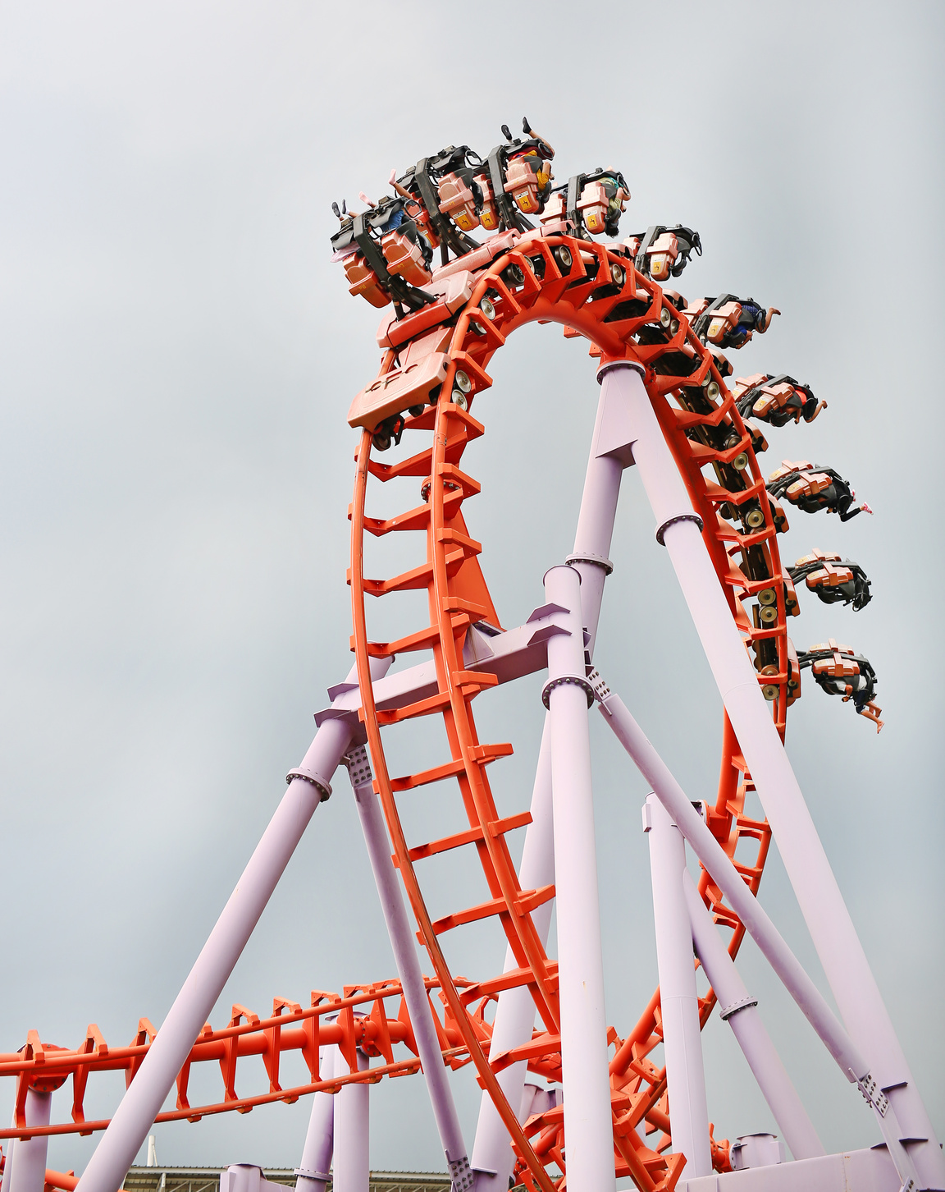
Dystopia and Utopia
Look at the following images. Which would be your dystopia and why?
Vocabulary check:
Dystopia (n): An imagined place where everything is bad and it is filled with injustice.
© We Teach

Slide 5
Frayer model
Complete the vocabulary task based on the word dystopia.
Definition
Word roots
Dystopia
Synonym
Antonym
Example sentence
© We Teach

Slide 6
Frayer model
Complete the vocabulary task based on the word dystopia.
Definition
An imagined bad place.
Word roots
Greek.
dys prefix means bad or abnormal.
topas means place.
Dystopia
Synonym
Hell. Apocalypse.
Nightmare.
Antonym
Utopia. Heaven. Paradise.
Example sentence
Hitler's regime replicates the dystopia of Orwell's 1984.
© We Teach

Slide 7

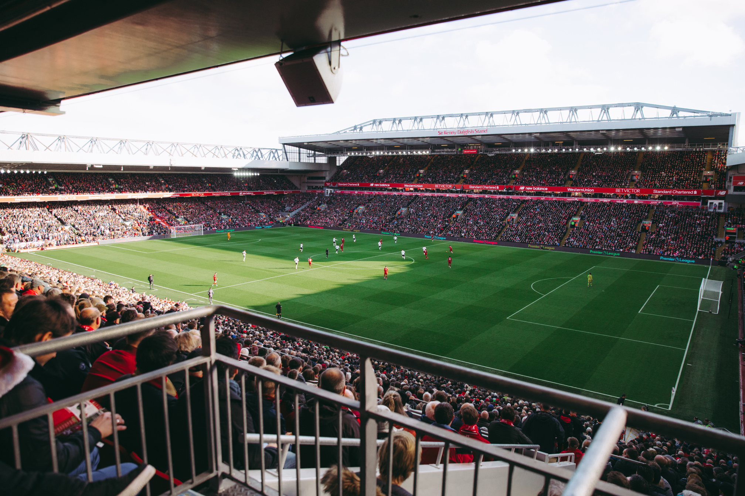

Dystopia and Utopia
Look at the following images. Which would be your utopia and why?
Vocabulary check:
Utopia (n): An imagined place where everything is good and it is considered to be perfect.
© We Teach

Slide 8
Frayer model
Complete the vocabulary task based on the word dystopia.
Definition
Word roots
Utopia
Synonym
Antonym
Example sentence
© We Teach

Slide 9
Frayer model
Complete the vocabulary task based on the word dystopia.
Word roots
Greek.
topas means place.
In modern Latin, it links to
a perfect imagined place.
Definition
An imagined perfect place.
Utopia
Synonym
Heaven. Nirvana. Paradise.
Antonym
Dystopia. Apocalypse.
Nightmare.
Example sentence
A trip to Disneyland would be my version of utopia.
© We Teach

Slide 10


Create your own utopia
Imagine you have the power to change the world.
What would your perfect world look like?
Discuss your ideas with your partner. You could consider:
  School
  Work
  Housing
  Jobs
  Laws
© We Teach

Slide 11
Create your own utopia
Use these prompts to help you to create your utopia:
  Who would be in charge?Would they be voted in or would they take control?
  Would children have to go to school? Would people have to go to work?
  Where would people live?How would they pay for things?
  Would you add or change any laws?
  How would you enforce your rules? Would there be any punishments?
Challenge prompts:
  Would your perfect world have a welfare system to look after the poor?
  Would your society have a National Health Service (NHS) or private health care?
Success criteria
In your writing, try to:
  Give detailed reasons for your ideas.
  Consider life for different members of society.
  Ensure you explain your ideas in full sentences.
© We Teach

Slide 12
Peer assessment
Share your work with someone else in the class. Read their work and comment on the following: Who would see their perfect world as a utopia? Who and why? Would anyone view their world as a dystopia? Who and why? What would be the biggest challenge in this perfect world?
Success criteria
In your writing, try to:
  Give detailed reasons for your ideas.
  Consider life for different members of society.
  Ensure you explain your ideas in full sentences.
© We Teach

Slide 13
Lesson aims
How do writers present political ideas?
Tier 2 vocabulary
Dystopia (n): An imagined place where everything is bad and it is filled with injustice.
Utopia (n): An imagined place where everything is good and it is considered to be perfect.
© We Teach

